Slide 1
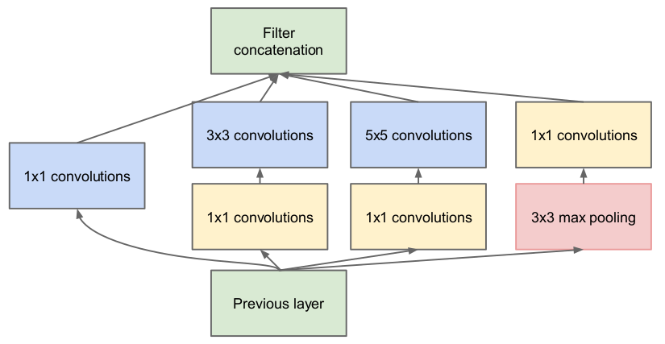
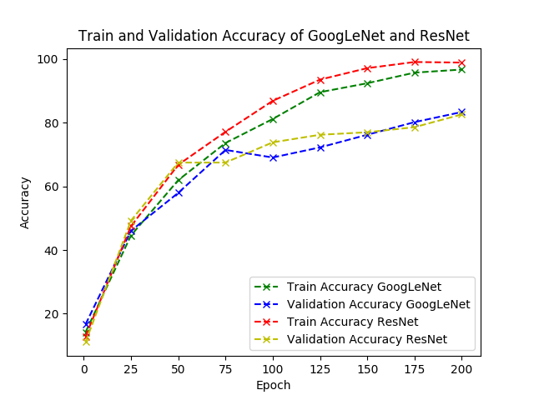
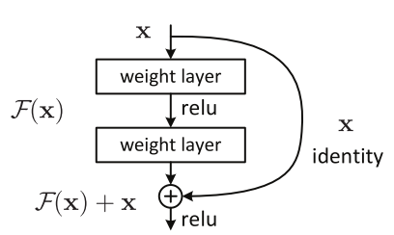
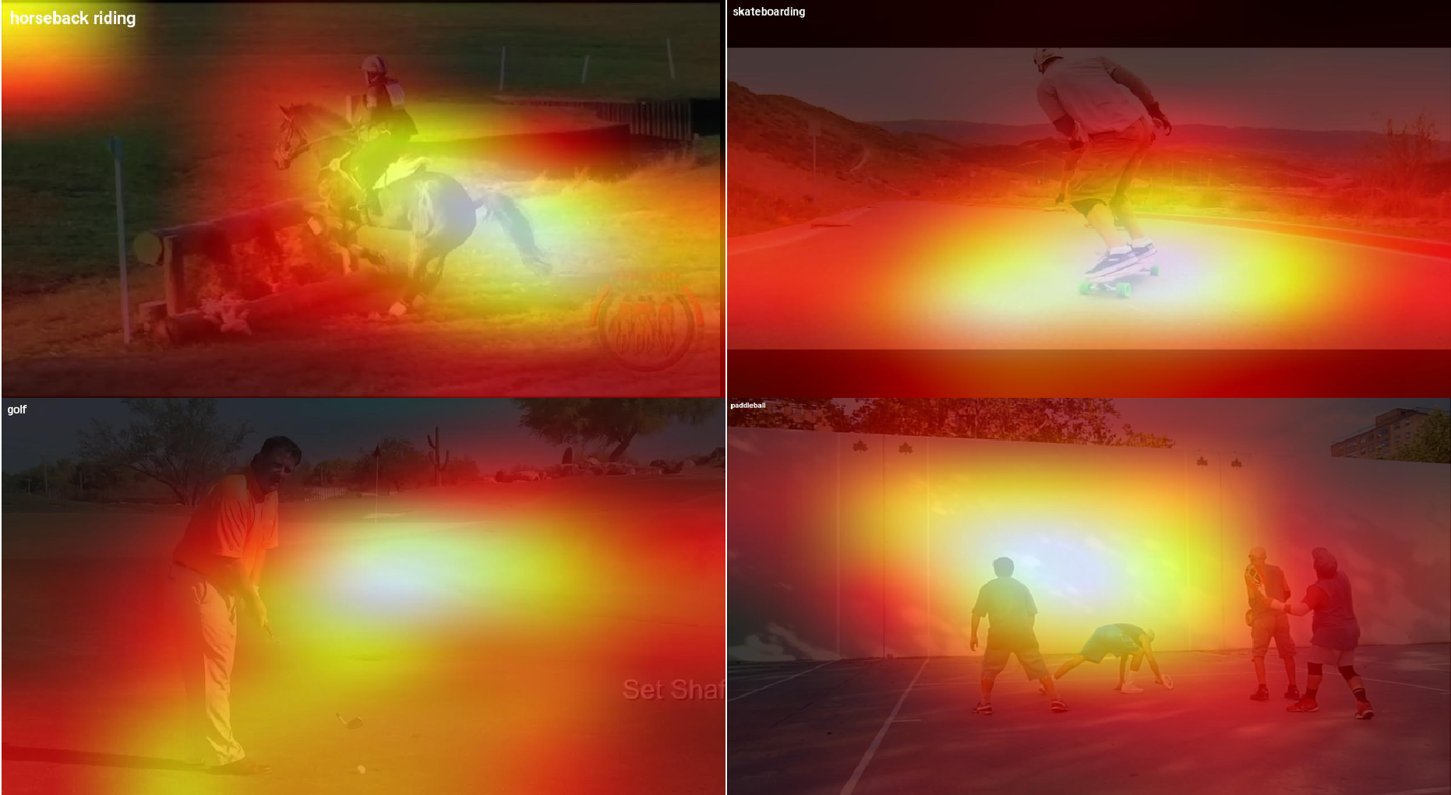
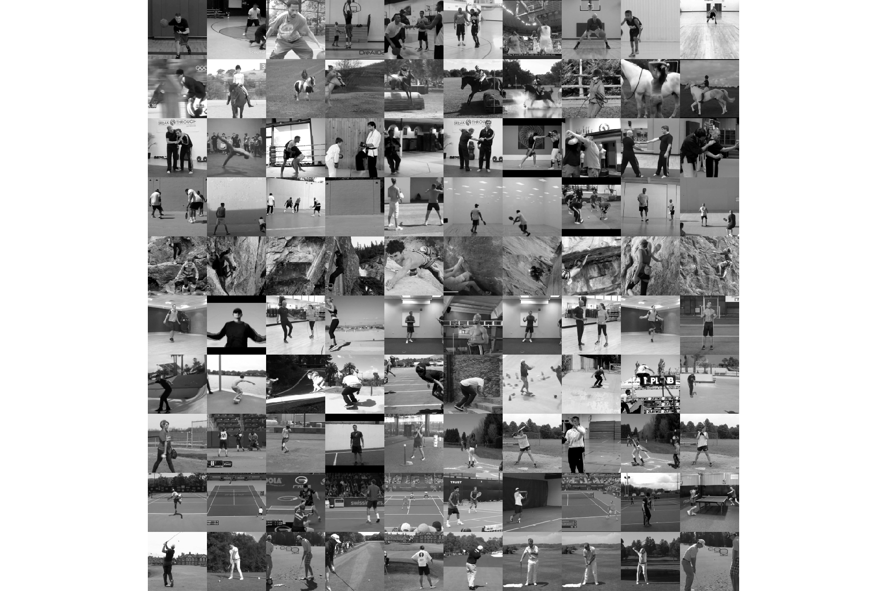
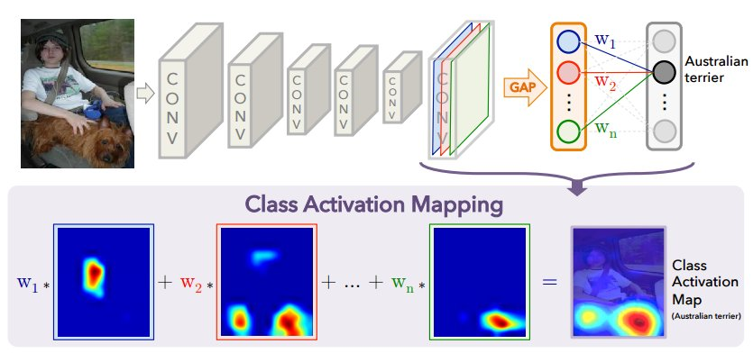
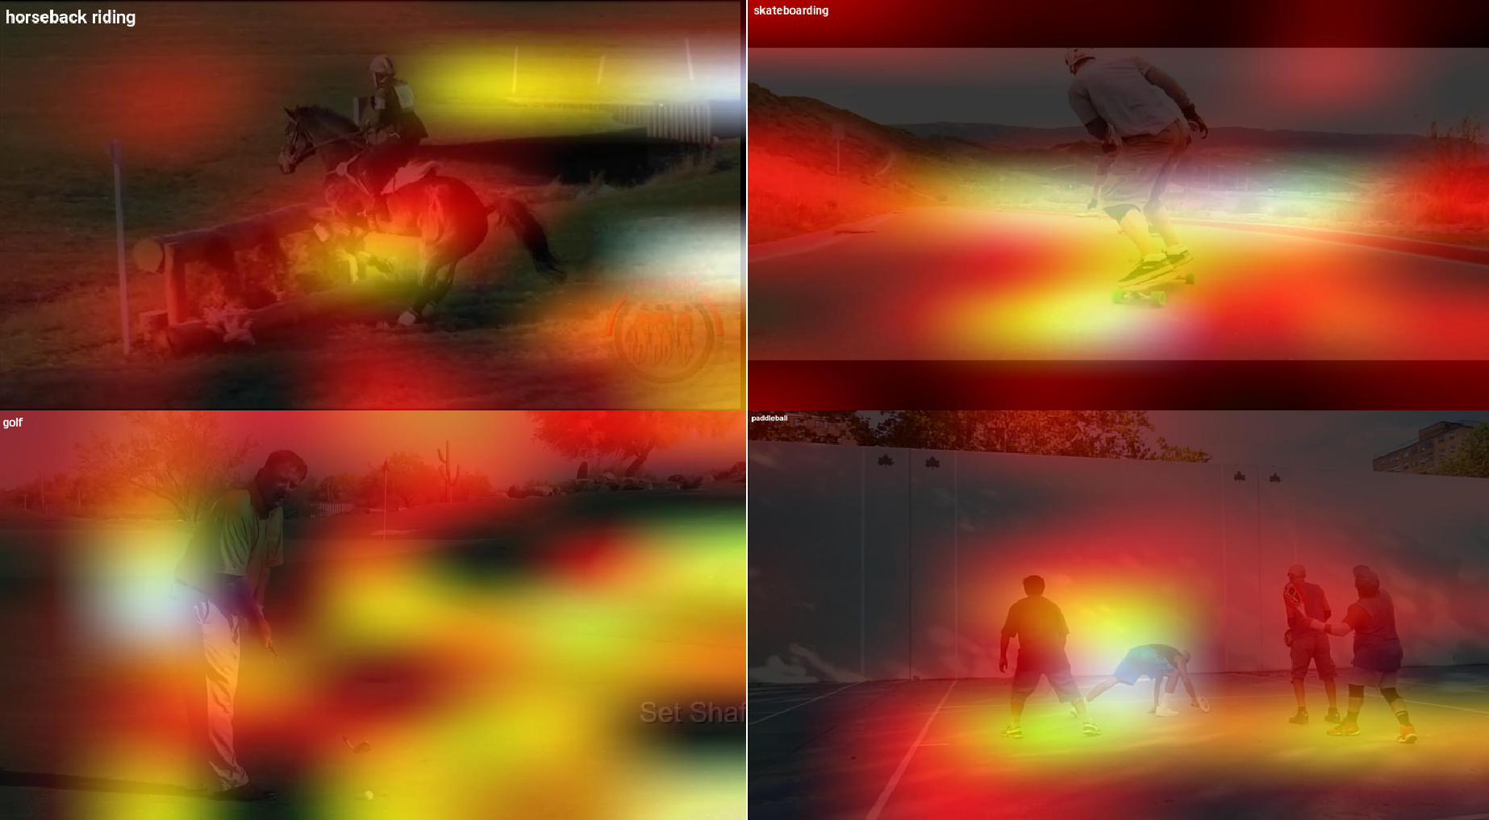
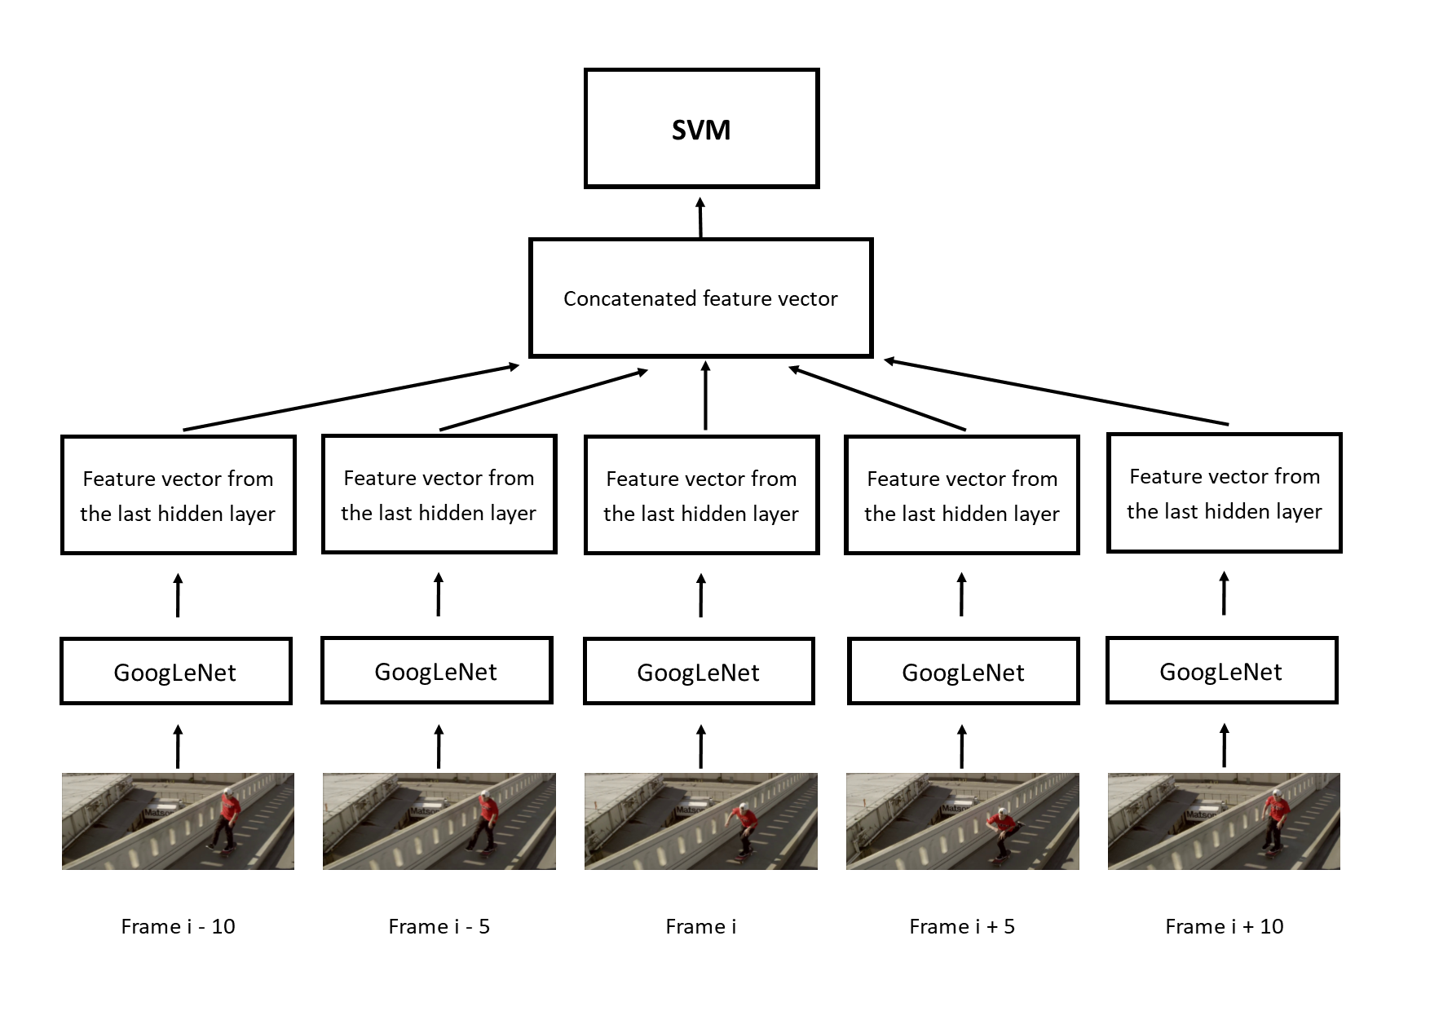
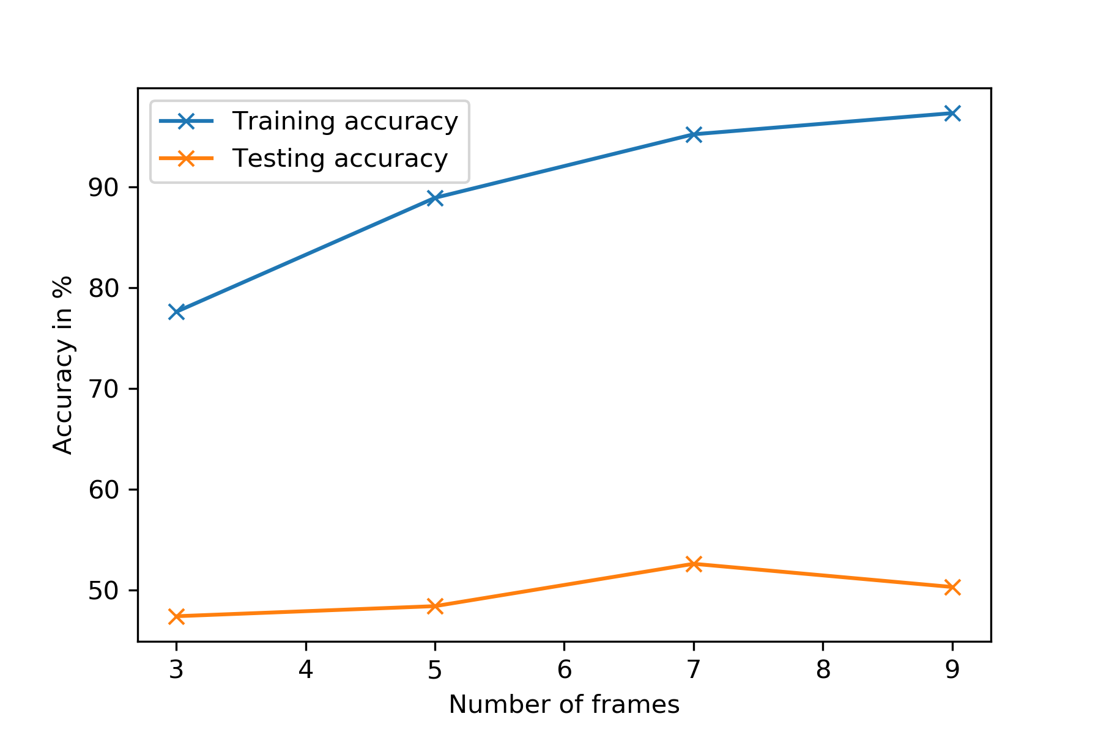
Sports Classification – Temporal vs. Static
Dominique Cheray & Manuel Krämer
Motivation
Materials and Methods
Results
GoogLeNet
27 layers deep network
9 Inception modules → reduce the number of parameters, create a deeper and wider topology
ResNet
34 layers deep network
Skip connections over residual blocks → more gradient flows backwards
Training and Testing
Softmax Loss as the classifier
Trained for 200 Epochs using SGD with 0.9 Momentum, 0.001 Learning Rate
and a fixed Learning Rate schedule (decrease LR by 4% every 8 epochs)
Split training images into training and validation set
Performed data augmentation on the training images
Final testing was done on the test images
Class Activation Mapping
Indicates the discriminative image regions used by the CNN to identify that class
Classification is an important task in searching and summarization
Most classification tasks don’t include sports → How do common networks perform on this task?
What are the networks looking at?
Sport contains lots of movements → Is temporal information important for classification?
Inception module
Classification with the Networks
Accuracy
Class Activation Mapping
Residual block
 | GoogLeNet | ResNet
Testing Accuracy | 82.3% | 76.1%
Data Set
Subset of MPII Human Pose Dataset → 10 sports: Basketball, Horseback riding, Martial Arts, Paddleball, Rock climbing, Rope skipping, Skateboarding, Softball, Tennis, Golf
1576 images total, 1266 training images, 310 test images
Four CAM examples for GoogLeNet
Class Activation Mapping
Four CAM examples for ResNet
Temporal Analysis with SVM
Samples of the dataset – one row is one class
 | Training Accuracy | Testing accuracy
3 frames with spacing 5 | 77.6% | 47.4%
5 frames with spacing 5 | 88.9% | 48.4%
7 frames with spacing 5 | 95.2% | 52.6%
9 frames with spacing 4 | 97.3% | 50.3%
References
Temporal Analysis with SVM
We use 3, 5, 7 or 9 successive frames with a distance of 5 frames (For 9 frames, 4 frames distance is used)
Every frame gets processed through the GoogLeNet until the last hidden layer
The output is a feature vector
All of them get concatenated and the final array is one instance for the SVM
Andriluka, M., Pishchulin, L., Gehler, P. and Schiele, B., 2014. 2d human pose estimation: New benchmark and state of the art analysis. In Proceedings of the IEEE Conference on computer Vision and Pattern Recognition (pp. 3686-3693).
Szegedy, C., Liu, W., Jia, Y., Sermanet, P., Reed, S., Anguelov, D., Erhan, D., Vanhoucke, V. and Rabinovich, A., 2015. Going deeper with convolutions. In Proceedings of the IEEE conference on computer vision and pattern recognition (pp. 1-9).
Zhou, B., Khosla, A., Lapedriza, A., Oliva, A. and Torralba, A., 2016. Learning deep features for discriminative localization. In Proceedings of the IEEE Conference on Computer Vision and Pattern Recognition (pp. 2921-2929).
The accuracy is increasing with more temporal information
Too many frames could involve a cut in the video
→ Worse testing accuracy
Notes:
1

